Slide 1
Requirements: Prototype, Minimal & Most
Benedikt Bosshammer
benedikt.bosshammer@sap.com

Slide 2
Prototype

Slide 3


Prototype
Cloud Platform
Exported Data from CiviCRM stored in HANA DB
Barcheck Web-App uses XSODATA Services via HTTP
Authentication: Basic Auth
New Data persisted in HANA DB
Barcheck-App
XSODATA
HANA DB

Slide 4
Minimal
Within SAP landscape and without SAP

Slide 5


Minimal within SAP landscape
Barcheck-App
Data transfer
Adapter (Authentication, Data- / System-Management)
Login
Contact Persons
authenticate
Cloud Platform
authenticate
Sales Data
Sluice
Drops
Microservice - Architecture

Slide 6
Minimal without SAP
Barcheck-App
Data transfer
Adapter (Authentication, Data- / Systemmanagement)
Login
Contact Persons
Server (e.g. Apache Container)
authenticate
authenticate
Sales Data
Sluice
Drops
Microservice - Architecture

Slide 7
Most
Within SAP landscape and without SAP

Slide 8
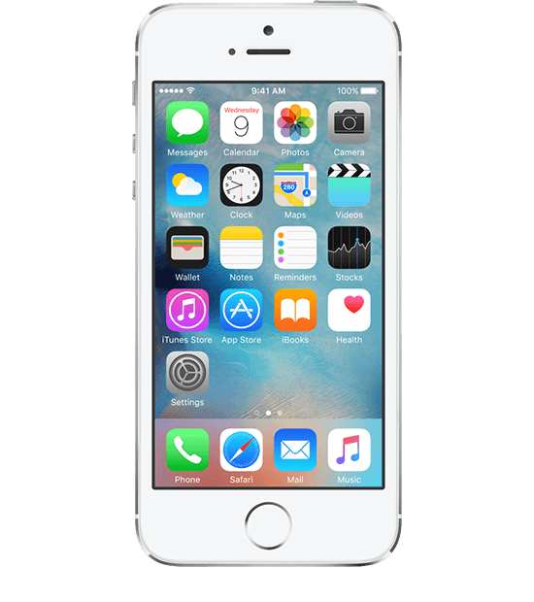
Most within SAP landscape
Sluice
Drops
Barcheck-App
Data transfer
http-Access
MS-Adapter (Authentication, Data- / System-Management)
Microservice - Architecture
Server (e.g. Apache Container)
Microservice wraps the CiviCRM API
Barcheck-App becomes part of the Microservice Architecture and
Barcheck-App just uses Drops, Sluice and CiviCRM wrapper for communication

Slide 9
Most without SAP
Sluice
Drops
Barcheck-App
Data transfer
http-Access
MS-Adapter (Authentication, Data- / Systemmanagement)
Microservice - Architecture
Server (e.g. Apache Container)
Microservice wraps the CiviCRM API
Barcheck-App becomes part of the Microservice Architecture and
Barcheck-App just uses Drops, Sluice and CiviCRM wrapper for communication

